Slide 1

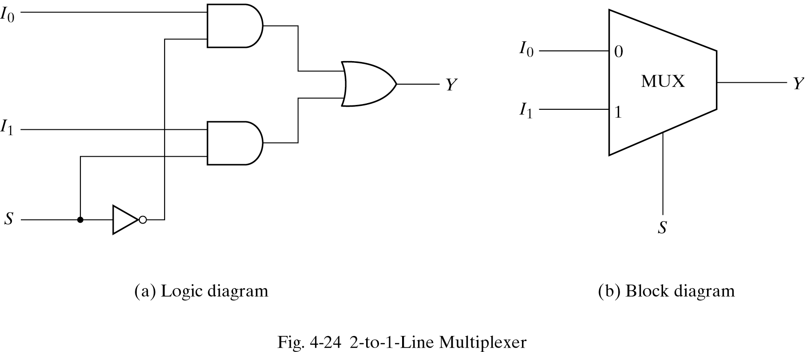
Multiplexers
S | Y
0 | I0
1 | I1
Definition:
Select an input value with
one or more select bits
Allows for conditional
transfer of data
In a 2×1 multiplexer, there
is one select switch and
two data lines.

Slide 2
Program 3.(2:1 Multiplexer)
Verilog Source File MUX2to1.v
Students need to complete this Verilog Source File MUX2to1.v
module mux2 (input wire i0, i1, j, output wire o);
assign o = --------------;
endmodule

Slide 3
2 to 1 MUX Testbench
module TB;
reg A,B,S;
wire X;
initial
begin
$dumpfile("MUX2_test.vcd");
$dumpvars(0,TB);
end
mux2 newMUX(.i0(A), .i1(B), .j(S), .o(X));

Slide 4
2 to 1 MUX Testbench(Contd…)
initial
begin
S = 1'b0;A = 1'b0;B = 1'b0;
#5 S = 1'b0;A = 1'b0;B = 1'b1;
#5 S = 1'b0;A = 1'b1;B = 1'b0;
#5 S = 1'b0;A = 1'b1;B = 1'b1;
#5 S = 1'b1;A = 1'b0;B = 1'b0;
#5 S = 1'b1;A = 1'b0;B = 1'b1;
#5 S = 1'b1;A = 1'b1;B = 1'b0;
#5 S=1'b1;A = 1'b1;B = 1'b1;
end
endmodule

Slide 5
2:1 MUX Simulation
Execute the files MUX2to1 and testBench2to1 as mentioned below
Step1) iverilog -o testmux2 MUX2to1.v MUX2to1_tb.v
If the compilation went OK, you won't see any output.
Step2) vvp testmux2
You can observe output on the console
Step3) gtkwave mux2_test.vcd
Output waveform will be observed

Slide 6
FOUR-INPUT MULTIPLEXER
In a 4×1 multiplexer, there
are two select switches and
four data lines.

Slide 7
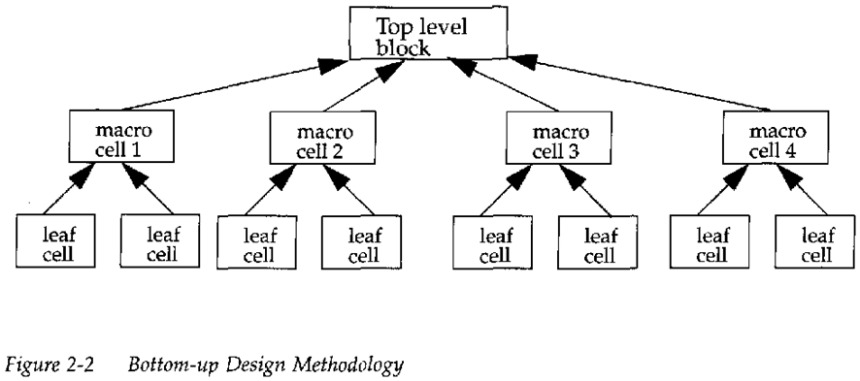
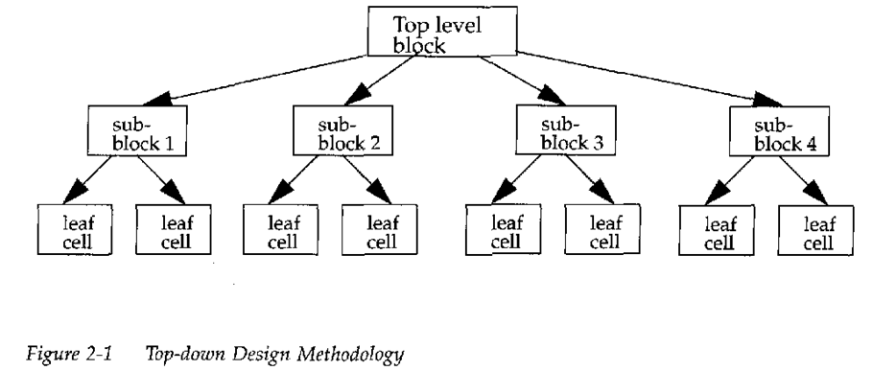
Hierarchical Designing
There are two design approaches when writing a code in hierarchical style
Top-Down Methodology: In Top-Down we first identify or define the big circuit or big block and then identify small block used to make this big block.
Bottom-Up Methodology: In this approach, we first identify small blocks that are available to us and use them to construct a big block.

Slide 8
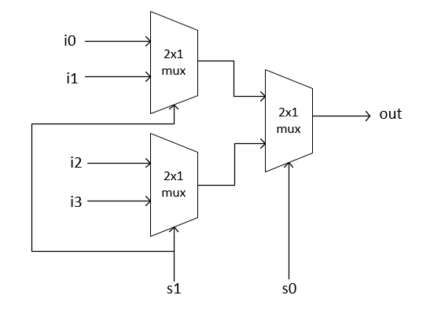
4:1 Mux using 2:1 Mux Multiplexers
i0 | i1 | i2 | i3 | s0 | s1 | out
1 | 0 | 1 | 1 | 0 | 1 | 0
0 | 1 | 0 | 0 | 0 | 1 | 1
0 | 0 | 1 | 0 | 1 | 0 | 1
0 | 0 | 0 | 1 | 1 | 1 | 1
1 | 0 | 0 | 0 | 0 | 0 | 1

Slide 9
Program 4(4:1 Multiplexer)
Verilog Source File MUX4to1.v
Students need to complete this Verilog Source File MUX4to1.v
module mux4 (input wire [0:3] i, input wire j1, j0, output wire o);
wire t0, t1;
mux2 mux2_0 (i[0],i[1],j1,t0); //see mux 2-i0,i1,j,o
mux2 mux2_1 (-------------------);
mux2 mux2_2 (-------------------);
endmodule

Slide 10
4 to 1 MUX Testbench
module TB;
reg [0:3]ii;
reg s0;reg s1;
‘wire yy;
initial
Begin
$dumpfile("MUX4_test.vcd");
$dumpvars(0, TB);
end
mux4 newMUX(.i(ii), .j0(s0),.j1(s1),.o(yy));
initial
begin

Slide 11
4 to 1 MUX Testbench(Contd…)
ii = 4'b0000;s0=1'b0;s1=1'b0;
#5 ii = 4'b1000;s0=1'b0;s1=1'b0;
#5 ii = 4'b0000;s0=1'b0;s1=1'b1;
#5 ii = 4'b0100;s0=1'b0;s1=1'b1;
#5 ii = 4'b0000;s0=1'b1;s1=1'b0;
#5 ii = 4'b0010;s0=1'b1;s1=1'b0;
#5 ii = 4'b0000;s0=1'b1;s1=1'b1;
#5 ii = 4'b0001;s0=1'b1;s1=1'b1;
end
endmodule

Slide 12
4 to 1 MUX Truthtable (Contd…)
i0 | i1 | i2 | i3 | s0 | s1 | y
0 | 0 | 0 | 0 | 0 | 0
1 | 0 | 0 | 0 | 0 | 0
0 | 0 | 0 | 0 | 0 | 1
0 | 1 | 0 | 0 | 0 | 1
0 | 0 | 0 | 0 | 1 | 1
0 | 0 | 1 | 0 | 1 | 1
0 | 0 | 0 | 0 | 1 | 1
0 | 0 | 0 | 1 | 1 | 1

Slide 13
4:1 MUX Simulation
Program 4.(4:1 Multiplexer using 2:1 Multiplexer)
- students have to complete MUX4to1.v file
Execute the files MUX2to1.v MUX4to1.v and MUX4to1_tb.v using steps below and observe the output
iverilog -o test_mux4 MUX2to1.v MUX4to1.v MUX4to1_tb.v
vvp test_mux4
gtkwave mux4_test.vcd

